Slide 1
CODE EXPLANATION
Naman Goel (2K19/EC/113)
Pranav Sharma(2K19/EC/126)

Slide 2
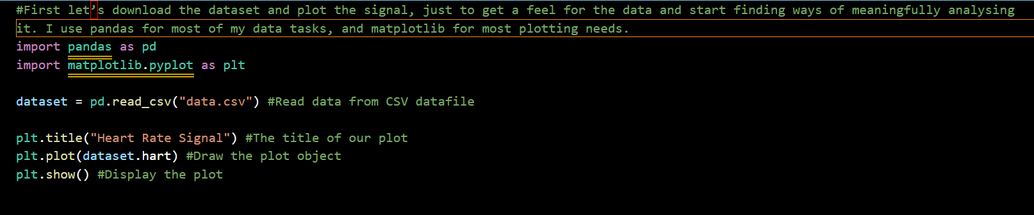
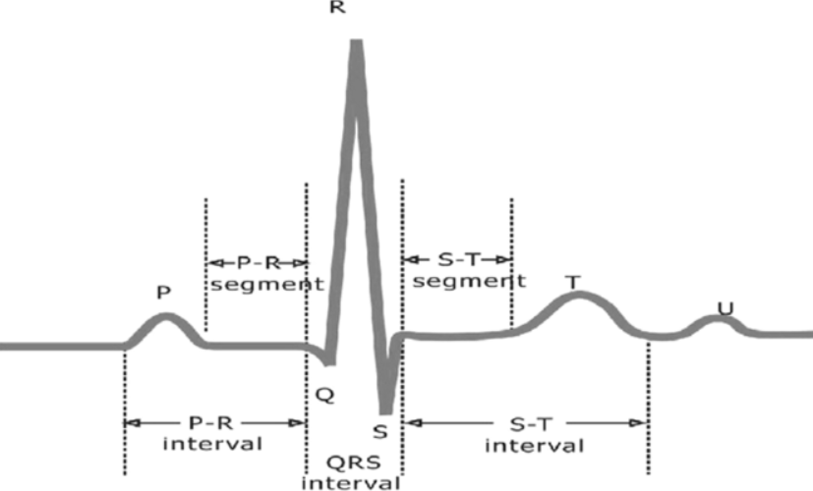
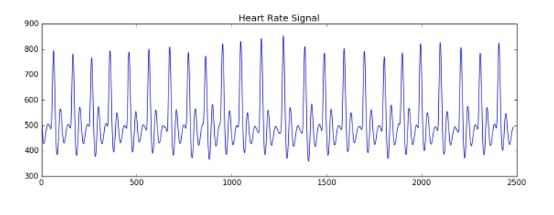
First Things First

Slide 3
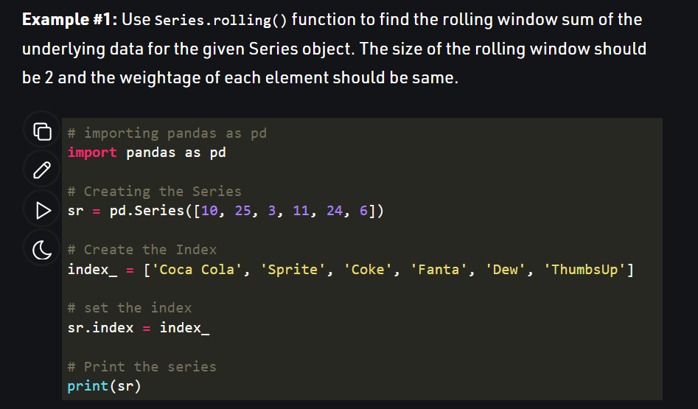
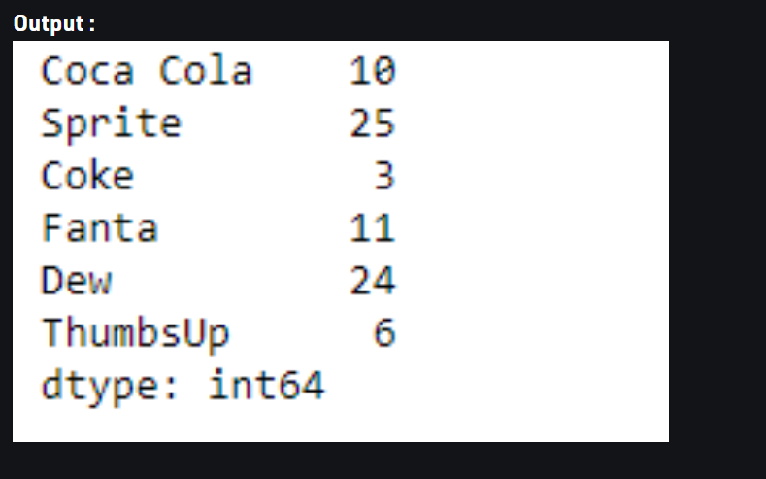
Rolling() function

Slide 4
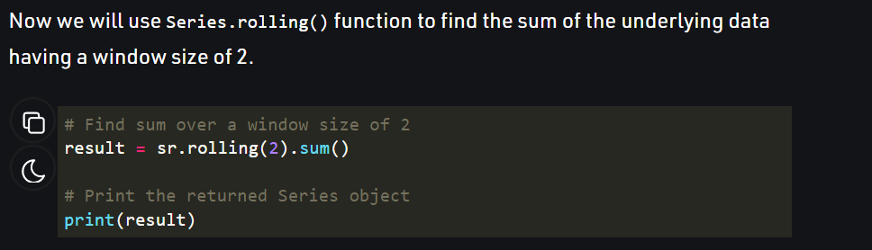
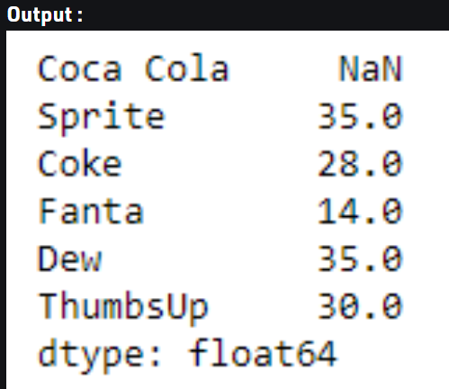
Rolling() function

Slide 5
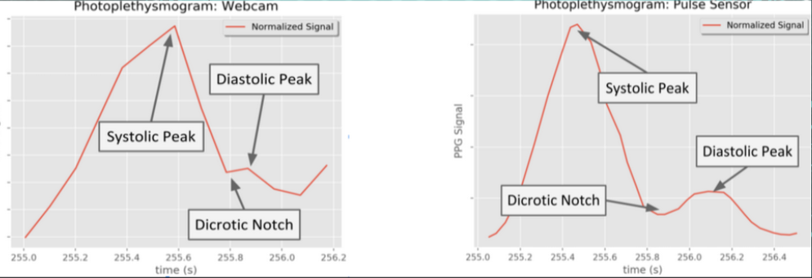

Slide 6
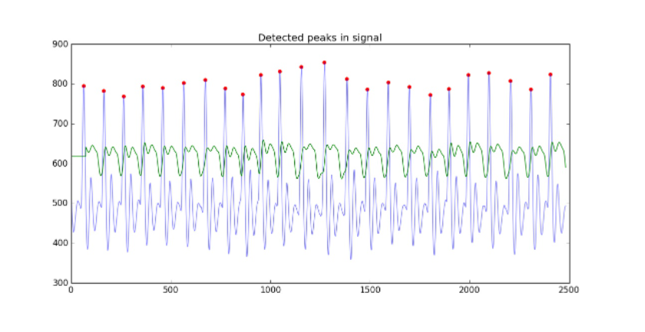

Slide 7
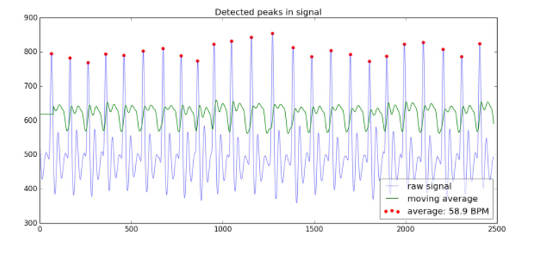
DETECTED PEAKS

Slide 8
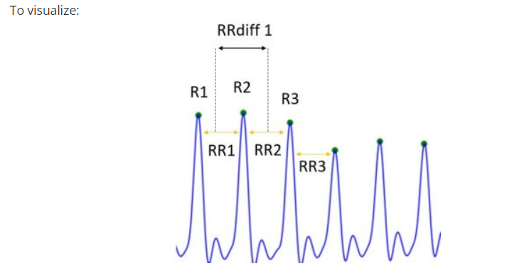
Time Series Data
For the time-series portion of the heart rate signal we are mostly concerned with the intervals between the heart beats and how they vary over time. We want the position of all R-complexes (R1, R2,…Rn), the intervals between them (RR1, RR2,…RRn, defined as ) and the differences between adjacent intervals (RRdiff-1,…RRdiff-n, defined as

Slide 9
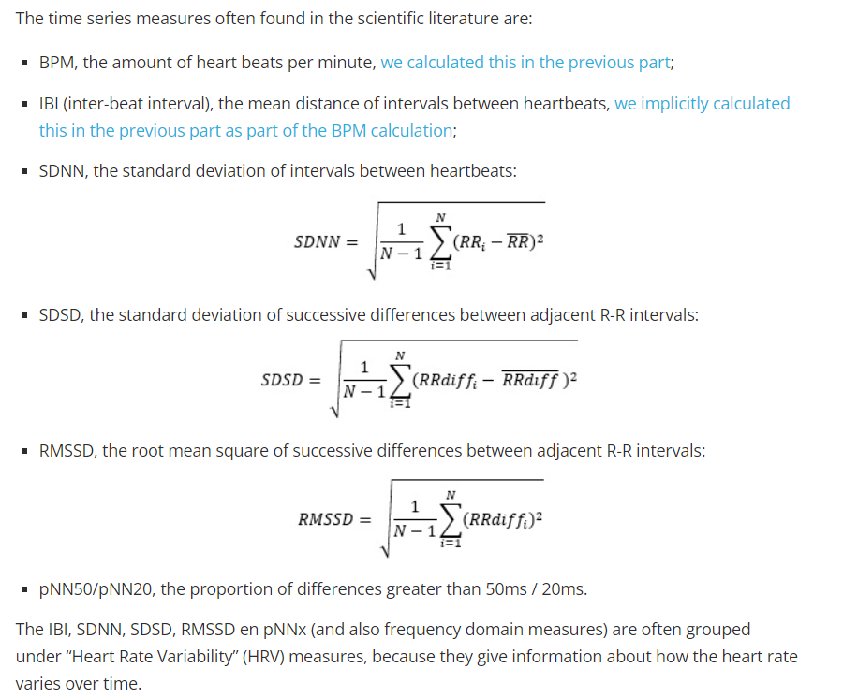

Slide 10
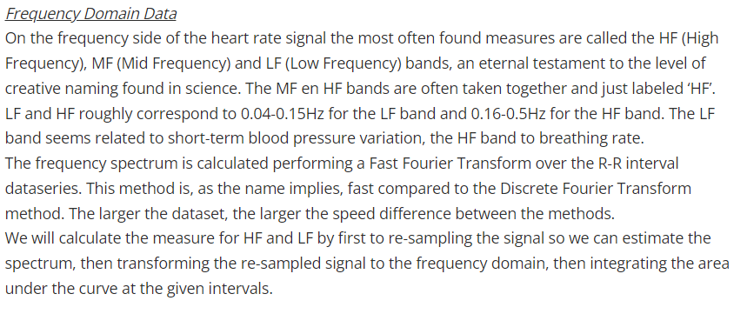

Slide 11
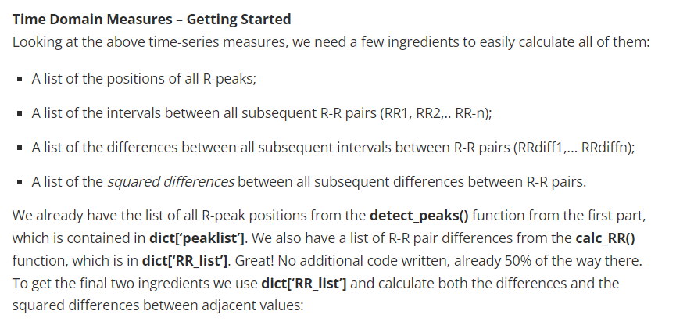

Slide 12
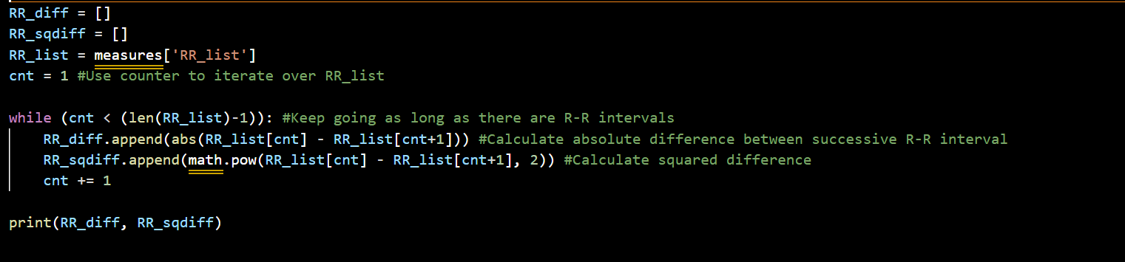
Time Domain Ingredients

